Slide 1



PERSONALIZED ACADEMIC INTERVENTIONS
USING ADAPTIVE AND EXPLAINABLE AI: MULTI-
MODAL LEARNING ANALYTICS FRAMEWORK
Final Year Research Final Presentation
Project ID - 25-26J-172
Team Members
Ravisanka U V P - IT22354792 (Component 01)
Disanayaka S T - IT22370228 (Component 02)
Nimanji D.L.K - IT22365750 (Component 03)
Perera I A T D - IT22902702 (Component 04)
05/05/2026
1

Slide 2
PP2 Comments & Actions Taken
 | IT22370228 | IT22365750 | IT22902702 | IT22354792
Panel Comment | task demo was done well system appears to be working as intended student posses some understanding of overall architecture and how the system function on a fundamental level |  | Overall Knowledge is ok | The risk factor displayed according to the student's app appears to be highly exhaggerated.
Action Taken | Enhanced the core application by coupling Machine Learning analytics with Generative AI, creating an automated pipeline that moves from accurate data prediction to personalized, actionable outputs | Uses Hybrid RAG with web search to provide higher accuracy and broader information coverage. | Optimized GRU and RL models with better accuracy and more reliable predictions. | Fixed by using Midterm Score as a substitute when Final Score is not yet available, preventing the model from treating a missing exam as a failing grade. Additionally, the student profile page was updated to clearly display all academic marks, lifestyle metrics, and the calculated risk score in one view.
05/05/2026
2

Slide 3


Problems
Many students struggle with specific lessons but do not realize their weak areas early
Learning difficulties are often detected only after exams
Student disengagement (low participation, inactivity) is not monitored continuously
Students lack instant academic support when studying independently
Existing systems do not combine prediction, explanation, engagement detection, and assistance in one platform
05/05/2026
3

Slide 4
Solutions (Proposed System)
The proposed solution is an integrated adaptive AI-based academic support system that continuously monitors student learning behavior and provides timely, personalized assistance.
The system:
Predicts student academic risk using adaptive ensemble machine learning
Explains risk predictions clearly to build trust and transparency
Recommends struggling students
Provides chatbot-based academic assistance using uploaded PDF materials
Detects student disengagement using LMS activity patterns
Delivers adaptive intervention actions to re-engage students early
05/05/2026
4

Slide 5


DESIGN AND IMPLEMENTATION OF AN ADAPTIVE ENSEMBLE MACHINE LEARNING ENGINE WITH EXPLAINABLE AI FOR REAL-TIME STUDENT RISK PREDICTION
Predicts student academic risk using a Hybrid Ensemble model (Random Forest + XGBoost + LightGBM).
Uses SHAP explanations to identify key risk and protective factors per student in a human readable format.
Provides a lecturer dashboard to update marks and trigger real-time risk recalculation, with results visible on the student profile.
IT22354792 |
Ravisanka U V P
25-26J-172
05/05/2026
5

Slide 6

DESIGN AND DEVELOPMENT OF AN INTEGRATED MACHINE LEARNING AND GENERATIVE AI PIPELINE FOR PERSONALIZED INTERVENTIONS
Developed a machine learning model (Random Forest Regressor) to simultaneously predict continuous student wellbeing and academic habit indices using ethically filtered, non-demographic behavioral data.
Coupled the predictive ML model with a Large Language Model (Llama 3.3) to automatically translate raw numerical risk scores into structured, highly personalized action plans.
IT22370228 |
Disanayaka S.T
05/05/2026
6

Slide 7

CONVERSATIONAL AI ASSISTANT FOR ADAPTIVE ACADEMIC INTERVENTIONS
An intelligent chatbot that helps students quickly access academic information.
It uses hybrid RAG with web search to provide accurate answers.
It supports multiple inputs and gives personalized inventions.
IT22365750 |
Nimanji D.L.K |
25-26J-172
05/05/2026
7

Slide 8

STUDENT DISENGAGEMENT DETECTION AND PERSONALIZED SUPPORT SYSTEM FOR RE-ENGAGEMENT
A machine learning system that identifies early signs of student disengagement using behavioral data.
It uses a GRU Autoencoder to analyze patterns like logins, activity time, and engagement trends.
Applies Reinforcement Learning to choose the best personalized actions like reminders, peer support, or escalation.
IT22902702 |
Perera I.A.T.D |
25-26J-172
05/05/2026
8

Slide 9
Results and Testimonials
Future Improvements
Student Disengagement Detection and Personalized Support System can be extended by integrating with academic systems like LMS and attendance platforms to provide a more complete view of student engagement.
Also it can be improved by adding student feedback on alerts, allowing it to understand which interventions are effective and adjust future actions accordingly.
The chatbot can be improved by adding advanced personalization to give proactive and student-specific support.
It can also be enhanced with smarter retrieval methods beyond basic RAG to provide more accurate and context-aware answers.
05/05/2026
9

Slide 10
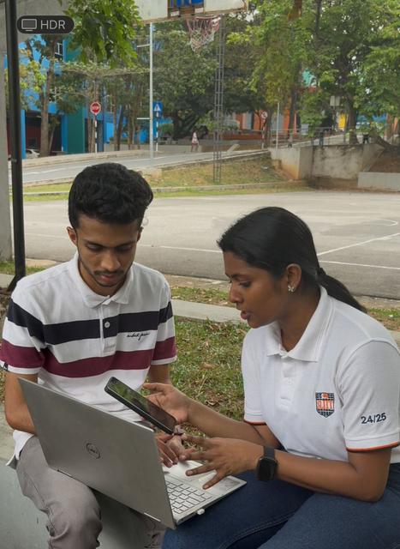
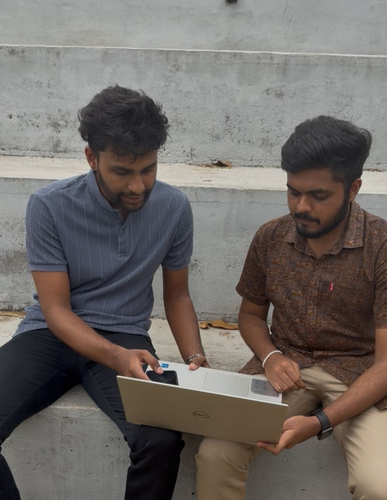
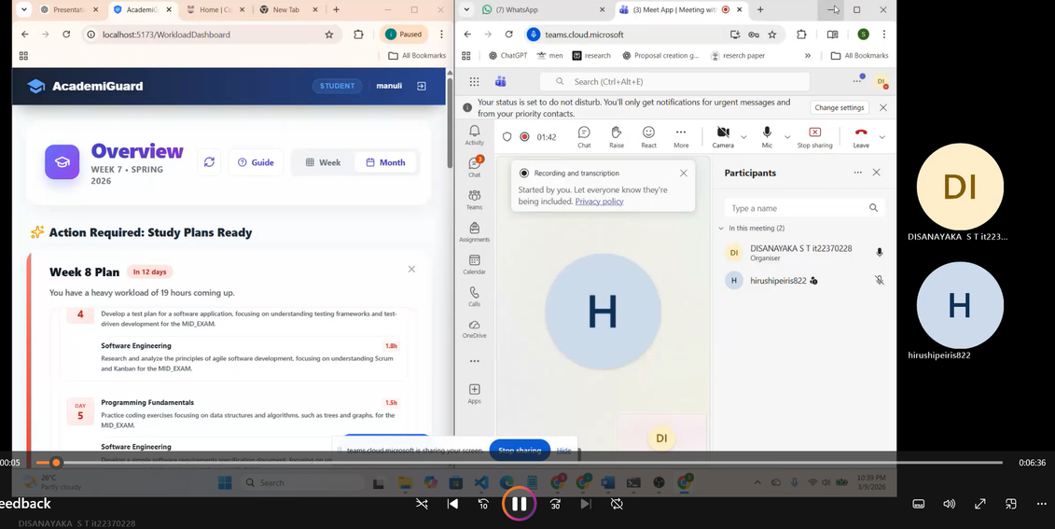
User Testing
05/05/2026
10

Slide 11
Thank You

